Slide 1
Lecture 6: Exploratory Data Analysis --
Descriptive Statistics

Slide 2
Data Science: Inference + Computation
Foundation of Data Science
Mathematics & Statistics
Computer Science (data structures + programming)
Statistical Thinking
Basis for modeling a big data project (Phase 3 of lifecycle)
Mathematical background
Linear algebra (lines, planes, vectors, matrices, linear equations, …)
Representation of data and relations
Computation and Visualization
Tools to process statistics

Slide 3
Descriptive Statistics
Descriptive statistics
produce statistics that summarize the data concisely (e.g. mean, average, standard deviation)
Exploratory data analysis
look for patterns, differences, and other features

Slide 4
Basic Statistical Concepts
Population
A population is a collection of objects about which information is sought
Sample
A sample is a part of the population that is observed
Example
#df.sample(100) returns a sample of 100 items from the a collection
#of score objects (which is a population)
df = pd.read_csv(‘scores.csv', index_col=0)
print(df.sample(100))

Slide 5
Population vs Sample
Population: all members of a group in a study
The average height of men
The average height of living male ≥ 18yr in USA between 2001 and 2010
The average height of all male students ≥ 18yr registered in Fall’17
Sample: a subset of the members in the population
Most studies choose to sample the population due to cost/time or other factors
i.e. most analysis performed on samples
Each sample is only one of many possible subsets of the population
May or may not be representative of the whole population
Need to choose sample carefully to draw valid/reasonable conclusion
Sample size and sampling procedure is important

Slide 6
Statistical terms of a single data set
Information (numbers) that give a quick and simple description of the data
Maximum value
Minimum value
Range (dispersion)
Mean
Median
Mode
Quantile
Variance
Standard deviation

Slide 7
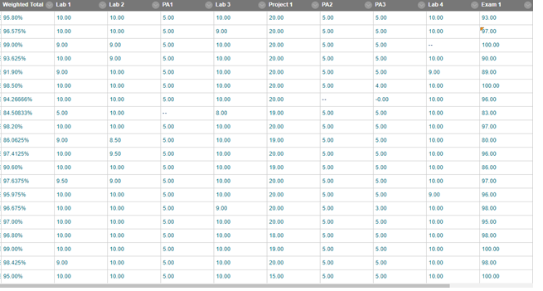
Example: Test scores

Slide 8
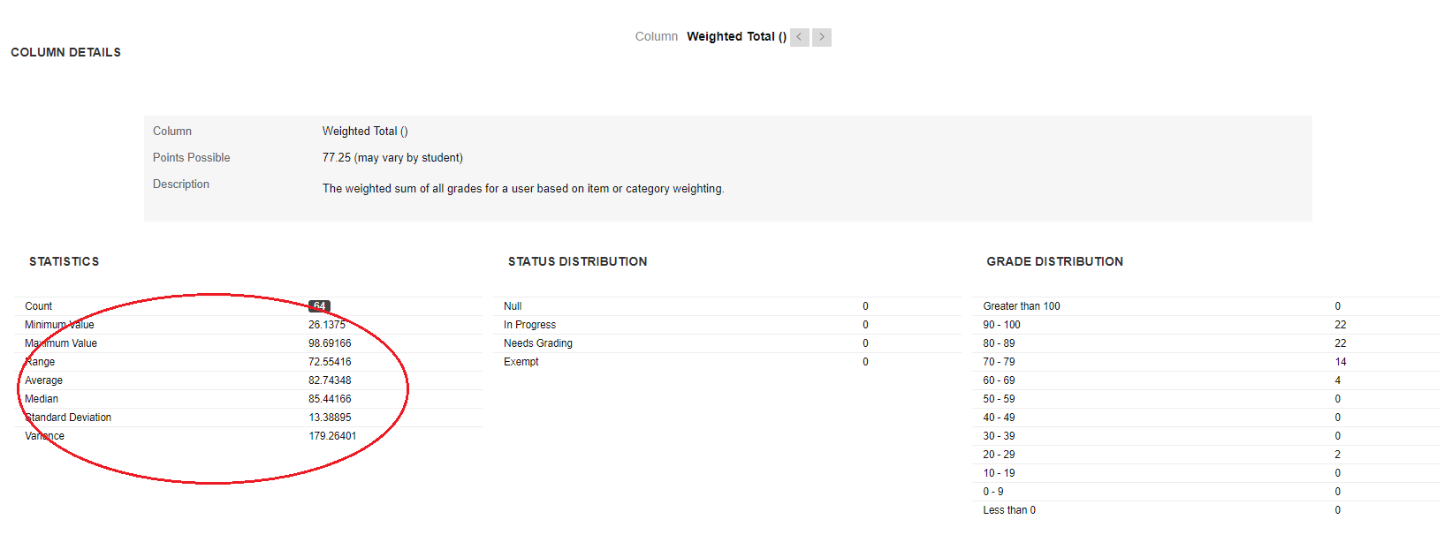
Score Statistics

Slide 9
Maximum, Minimum and Range
Very familiar concepts
Maximum: greatest/largest element of a sample
Minimum: least/smallest element of a sample
Range: the difference between the minimum and maximum (max – min)
Example: find the maximum, minimum and range for the following list of values
13, 18, 13, 14, 13, 16, 14, 21, 13
Minimum: 13
Maximum: 21
Range: 21-13 = 8

Slide 10
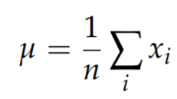
Definitions: Mean, Median, Mode
Mean (also called average, or arithmetic average)
For a sample of n values, xi (i=1,…,n), the mean, µ, is the sum of the values divided by the number of values

Slide 11
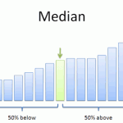
Median: The median is a simple measure of central tendency.
To find the median, we arrange the observations in order from smallest to largest value (i.e. sorted)
If there is an odd number of observations, the median is the middle value.
If there is an even number of observations, the median is the average of the two middle values.

Slide 12
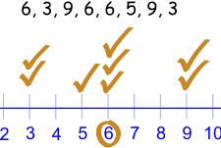
Mode: the most frequently occurring number found in a set of numbers.
The mode is found by collecting and organizing data in order to count the frequency of each result.
The result with the highest number of occurrences is the mode of the set.

Slide 13
Activity #1
Now work in groups:
Find the mean, median, mode, and range for the following list of values: 13, 18, 13, 14, 13, 16, 14, 21, 13
What is the mean, median, mode and range for the Exam #1?
Pay attention to: Mean vs. Median

Slide 14

mean vs. average
(Arithmetic) Mean: the “average” value of the data
Average: can be ambiguous
The average household income in this community is $60,000
The average (mean) income for households in this community is $60,000
The income for an average household in this community is $60,000
What if most households are earning below $30,000 but one household is earning $1M
def mean(a): return sum(a) / float(len(a))
def mean(a): return reduce(lambda x, y: x+y, a) / float(len(a))

Slide 15
median vs. mode
Median: the “middlest” value, or mean of the two middle values
Obtained by sorting the data first
Does not depend on all values in the data.
More robust to outliers
Mode: the most-common value in the data

Slide 16
Variance
Let’s look at two examples
Apples are all pretty much the same size (at least the ones sold in supermarkets). So if you buy 6 apples and the total weight is 3 kgs, it would be a reasonable summary to say they are about 0.5kg each.
But pumpkins are more diverse. Suppose there are several varieties in a garden, three decorative pumpkins that are 1 kg each, two pie pumpkins that are 3 kgs each, and one Giant pumpkin that weighs 591 kgs. The mean is 100 kgs. However, if we say “The average pumpkin in my garden is 100 kgs” that is misleading, at least not clear.

Slide 17
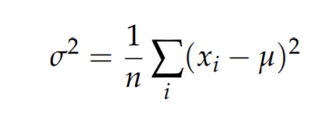
Variance and Standard Deviation
If there is no single number that summarizes pumpkin weights, we can do a little better with two numbers: mean and variance.
mean is intended to describe the central tendency,
variance is intended to describe the spread.
Deviation from the mean: xi-µ
Variance: σ²
Standard deviation: σ (the square root of variance)

Slide 18
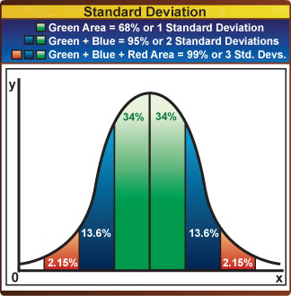
Standard Deviation Illustration

Slide 19
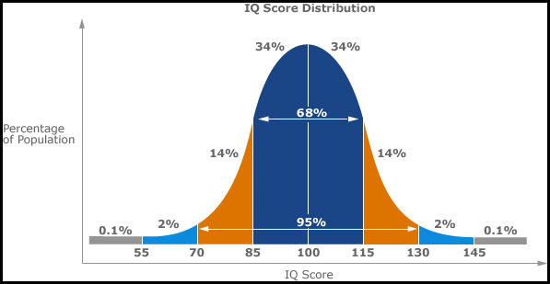
Standard Deviation Example
Question: in this example standard deviation = ?
mean = ?

Slide 20
Activity #2
1. Calculate the variance and standard deviation of
The sequence of 13, 18, 13, 14, 13, 16, 14, 21, 13
The 6 pumpkins weighted 1, 1, 1, 3, 3, 591
Question: which sequence has larger variance?
2. Assume the mean score of Exam 1 is 70 (which is a C), which of the following case(s) you are more likely to get a C grade? (or in each case what grade you estimate/expect to receive?)
Your score is 66 and the standard deviation is 2
Your score is 66 and the standard deviation is 5
Your score is 78 and the standard deviation is 1

Slide 21
Pandas Data Frames methods
Unlike attributes, python methods have parenthesis.
All attributes and methods can be listed with a dir() function: dir(df)
df.method() | description
head( [n] ), tail( [n] ) | first/last n rows
describe() | generate descriptive statistics (for numeric columns only)
max(), min() | return max/min values for all numeric columns
mean(), median() | return mean/median values for all numeric columns
std() | standard deviation
sample([n]) | returns a random sample of the data frame
dropna() | drop all the records with missing values

Slide 22
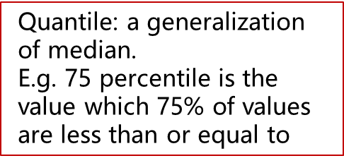
Quantile
In statistics quantiles are cut points dividing the range of a probability distribution into continuous intervals with equal probabilities, or dividing the observations in a sample in the same way.

Slide 23
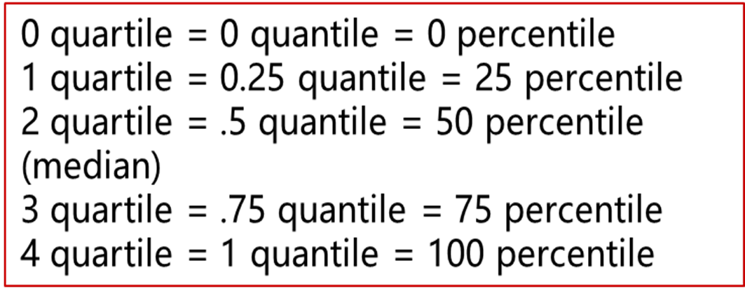
Quantile vs. Quartile vs. Percentile
Quartile: each of four equal groups into which a population can be divided according to the distribution of values of a particular variable.

Slide 24
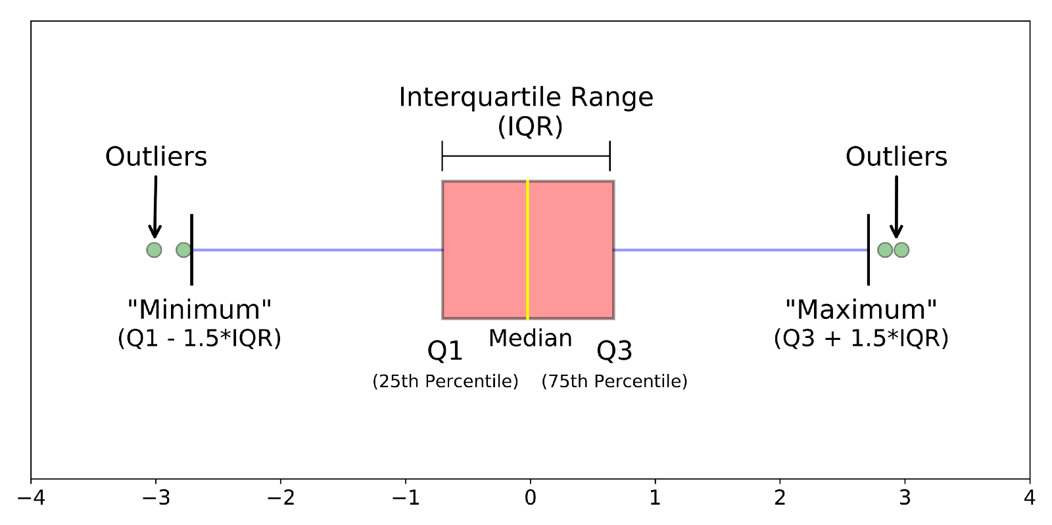
Box plot

Slide 25
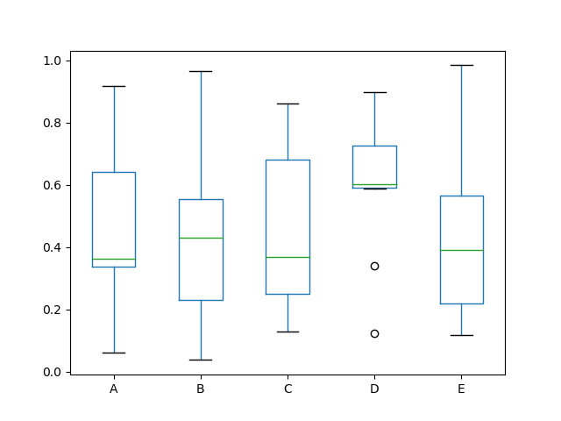
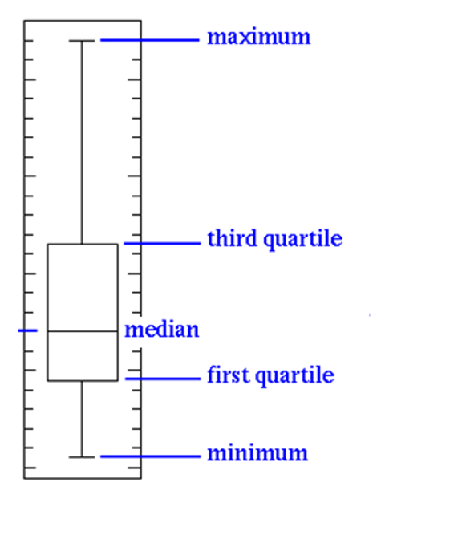
df = pd.DataFrame(np.random.rand(10, 5), columns=['A', 'B', 'C', 'D', 'E'])
df.plot.box()

Slide 26
Activity #3
Given the dataset 0.1, 0.95, 0.4, 0.7, 0.8, 0.2, 0.3, 0.25, 0.6, 0.45, which of the box plot shown in previous slide will look like (i.e. close to) to the box plot for this dataset? (Select one without actually drawing the box plot for the above dataset.)
A (2) B (3) C (4) D (5) E
Use Pandas to draw the box plot for the above dataset.

Slide 27
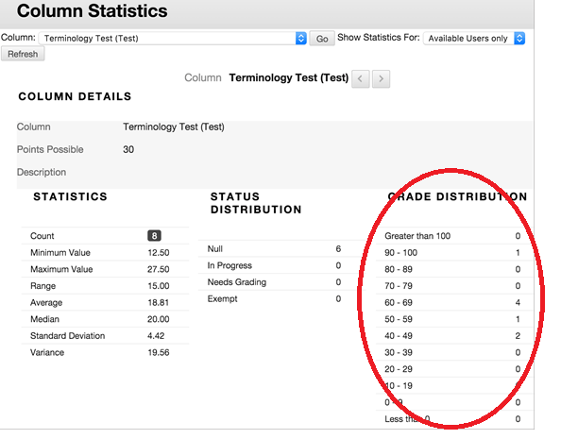
Distribution
Describes how often each value appears.
The most common representation of
a distribution is a histogram

Slide 28
Statistical Definition of Histogram
A histogram is a display of statistical information that uses rectangles to show the frequency of data items in successive numerical intervals of equal size.
In the most common form of histogram, the independent variable is plotted along the horizontal axis and the dependent variable is plotted along the vertical axis.

Slide 29
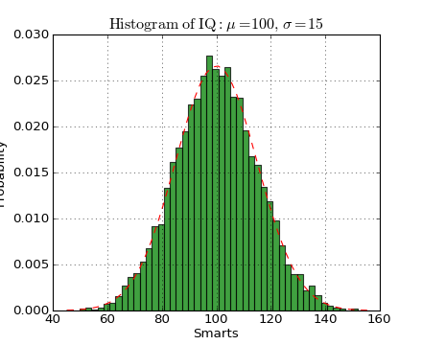
import numpy as np
import matplotlib.mlab as mlab
import matplotlib.pyplot as plt
mu, sigma = 100, 15
x = mu + sigma*np.random.randn(10000)
# the histogram of the data
n, bins, patches = plt.hist(x, 50, normed=1, facecolor='green', alpha=0.75)
# add a 'best fit' line
y = mlab.normpdf( bins, mu, sigma)
l = plt.plot(bins, y, 'r--', linewidth=1)
plt.xlabel('Smarts')
plt.ylabel('Probability')
plt.title(r'$\mathrm{Histogram\ of\ IQ:}\ \mu=100,\ \sigma=15$')
plt.axis([40, 160, 0, 0.03])
plt.grid(True)
plt.show()

Slide 30
Outliers
Outliers are values that are far from the central tendency.
Question: which term describes the central tendency?
Outliers might be caused by errors in collecting or processing the data, or they might be correct but unusual measurements.
It is always a good idea to check for outliers, and sometimes it is useful and appropriate to discard them.

Slide 31
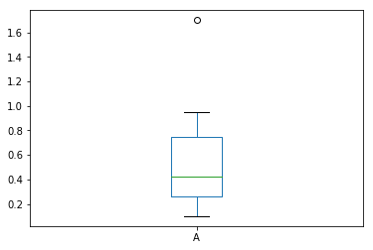
Plotting Outliers
Dataset: [0.1, 0.95, 0.4, 1.7, 0.8, 0.2, 0.3, 0.25, 0.6, 0.45 ]
Outlier: 1.7
(as shown on box plot)
df = pd.DataFrame(np.array([0.1, 0.95, 0.4, 1.7, 0.8, 0.2, 0.3, 0.25, 0.6, 0.45 ]), columns=['A'])
df.plot.box()

Slide 32
Exploring Your Data
The simplest case is when you have a one-dimensional data set, which is just a collection of numbers. For example,
daily average number of minutes each user spends on your site,
the number of times each of a collection of data science tutorial videos was watched,
the number of pages of each of the data science books in your data science library.
An obvious first step is to compute a few summary statistics.
You’d like to know how many data points you have, the smallest, the largest, the mean, and the standard deviation.
But even these don’t necessarily give you a great understanding.

Slide 33
CDC BRFSS Dataset
The Behavioral Risk Factor Surveillance System (BRFSS) is the nation's premier system of health-related telephone surveys that collect state data about U.S. residents regarding their health-related risk behaviors, chronic health conditions, and use of preventive services.
https://www.cdc.gov/brfss/annual_data/annual_data.htm
Practice
BRFSS dataset analysis

Slide 34
Summary
Introduced popularly used statistical terms for exploratory data analysis
How we summarize data? What formula to use? What’s the meaning of each formula?
Project #1: A good practice for exploratory data analysis
Assignment
Project #1
Next Lecture: Part I wrap up

